Slide 1
Chicago Beaches Water Quality Prediction
Open Source Civic Tech Collaborative Data Science Project
Rebecca Jones

Slide 2
Overview
Context of project : ChiHackNight collaboration
Description of problem : E. Coli prediction, both important and difficult
Modeling approach : Ensemble of GBM and Random Forest models
Results : Performance comparisons
Reflections : Pros and cons of collaborative data science work

Slide 3


Chicago's weekly event to build, share & learn about civic tech.
Every Tuesday 6-9pm at Merchandise Mart 8th floor, Braintree offices.
Brings together people with technical skills and people with knowledge of aspects of civic life that can be improved by better use of data and technology.
https://chihacknight.org/
Tom Schenk, Chief Data Officer.
https://data.cityofchicago.org/

Slide 4
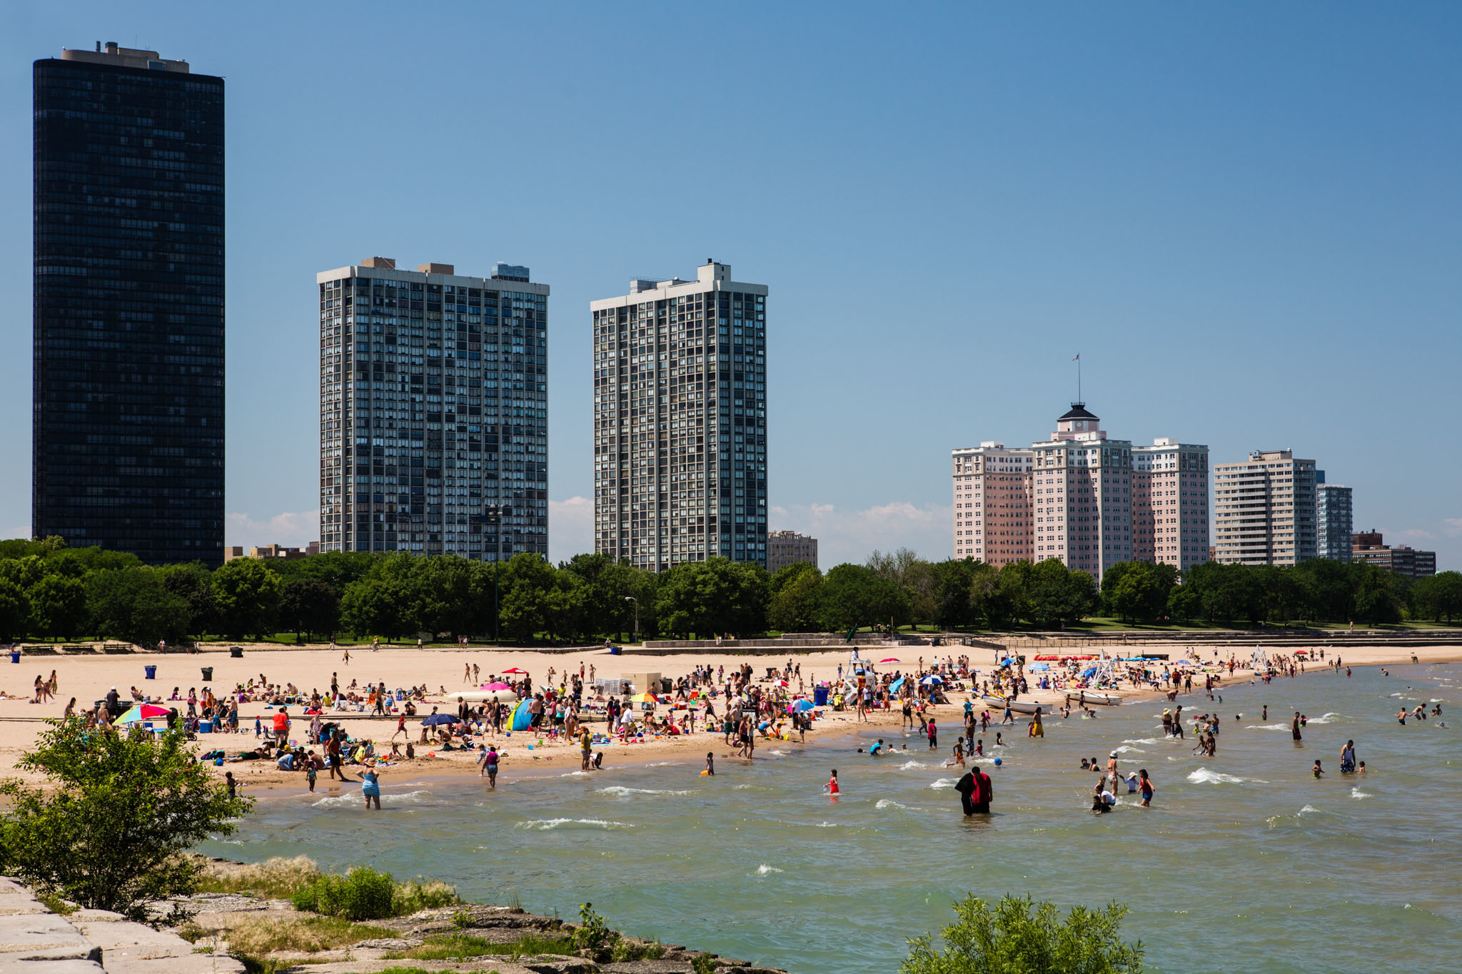
Escherichia coli : monitored as indicator of microbial contamination
Pathways for bacterial contamination
Local
Geese and other birds. Animal waste.
Runoff from streets and waterways. Washout of bacterial load buildup on beachfront.
Non functioning storm drains. Illicit discharges. Sewer overflows.
Notes:
Swim advisories at Chicago’s beaches are issued when test results show bacteria counts to be higher than 235 colony forming units per 100 milliliters of water, an EPA standard which is used by all Great Lakes beach managers. That means there is a 75 percent chance that at least eight out of 1,000 people will develop gastroenteritis. A swim ban is issued only for hazards like sewage spills or weather conditions.
http://chicago.suntimes.com/news/pilot-program-tests-bacteria-at-city-beaches-in-just-hours/

Slide 5
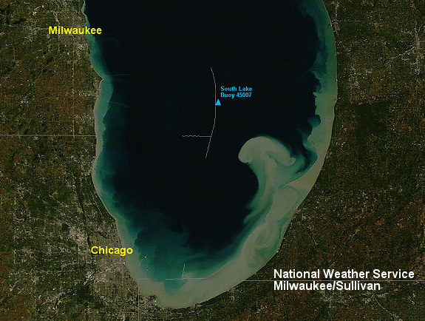
Escherichia coli : monitored as indicator of microbial contamination
Pathways for bacterial contamination
Local
Geese and other birds. Animal waste.
Runoff from streets and waterways. Washout of bacterial load buildup on beachfront.
Non functioning storm drains. Illicit discharges. Sewer overflows.
Regional
Storm surges. Sediment resuspension.
Turbidity currents. Flows from rivers.
Notes:
Swim advisories at Chicago’s beaches are issued when test results show bacteria counts to be higher than 235 colony forming units per 100 milliliters of water, an EPA standard which is used by all Great Lakes beach managers. That means there is a 75 percent chance that at least eight out of 1,000 people will develop gastroenteritis. A swim ban is issued only for hazards like sewage spills or weather conditions.
http://chicago.suntimes.com/news/pilot-program-tests-bacteria-at-city-beaches-in-just-hours/

Slide 6
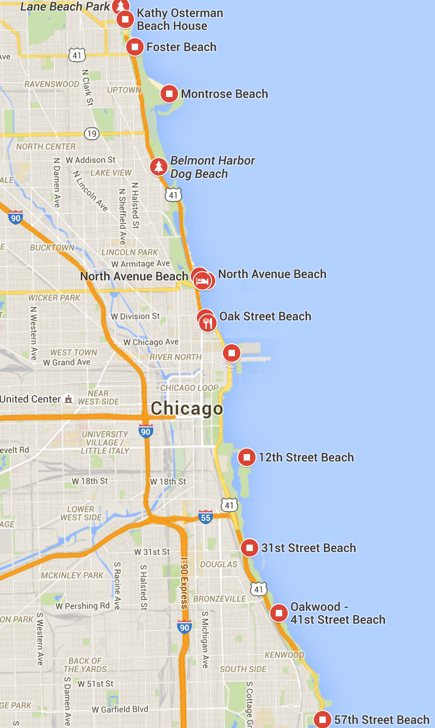
Chicago Beach Monitoring:
Notes:
Swim advisories at Chicago’s beaches are issued when test results show bacteria counts to be higher than 235 colony forming units per 100 milliliters of water, an EPA standard which is used by all Great Lakes beach managers. That means there is a 75 percent chance that at least eight out of 1,000 people will develop gastroenteritis. A swim ban is issued only for hazards like sewage spills or weather conditions.
http://chicago.suntimes.com/news/pilot-program-tests-bacteria-at-city-beaches-in-just-hours/

Slide 7
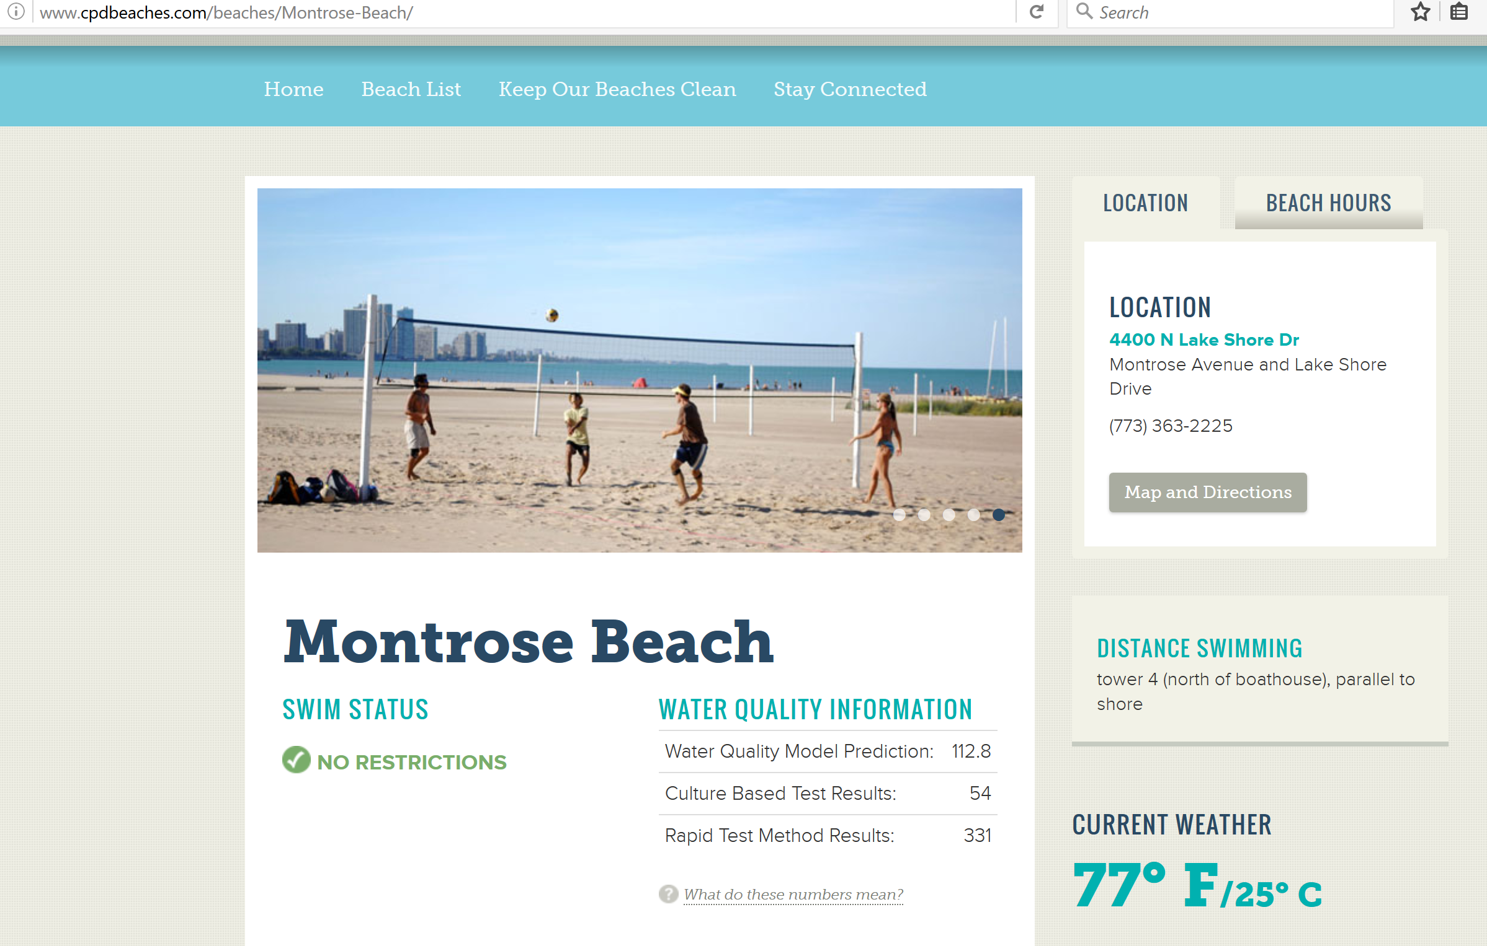
Chicago Beach Monitoring:
Notes:
The Chicago Park District tests the water for Escherichia coli bacteria. Escherichia coli is not harmful itself and is naturally occurring in the environment. However, this bacteria is an indicator of the presence of other germs that could make you sick. US Environmental Protection Agency (USEPA) beach policy recommends notifying the public when E. coli bacteria levels are above the federal water quality Beach Action Value (BAV), which is 235*. This standard is used at beaches throughout the Great Lakes region. For more information please refer to the USEPA Recreational Water Quality Criteria.
The Chicago Park District in partnership with the US Geological Survey, has also developed statistical models that use weather data to predict the bacteria levels in real-time. These models provide information about water quality in real-time, compared to 18-24 hours to get results from a lab for traditional water quality testing. The models were developed with grant funding from the EPA's Great Lakes Restoration Initiative. When bacteria levels are detected (or predicted to be) above 235, CPD posts an advisory at the beach. *The unit of measurement for Escherichia coli is "Colony Forming Units (CFU) per 100 milliliters of water."

Slide 8
Chicago Beach Monitoring:
2015 results from current USGS predictive model
BEACH | incorrect_warning | correct_warning | missed_warning
Juneway | 0 | 0 | 5
Rogers | 0 | 0 | 7
Howard | 0 | 0 | 7
Jarvis | 0 | 0 | 2
Leone | 0 | 0 | 4
Albion | 0 | 0 | 6
Osterman | 0 | 0 | 14
Foster | 1 | 0 | 9
Montrose | 1 | 5 | 26
North Avenue | 0 | 0 | 5
Oak Street | 0 | 0 | 1
Ohio | 1 | 0 | 13
12th | 0 | 0 | 11
31st | 2 | 1 | 12
Oakwood | 2 | 0 | 6
57th | 2 | 1 | 4
63rd | 2 | 1 | 11
South Shore | 2 | 1 | 13
Rainbow | 3 | 4 | 17
Calumet | 0 | 0 | 30
Warnings are issued when model predicts bacteria counts to be higher than 235 colony forming units per 100 milliliters of water.
Notes:
Swim advisories at Chicago’s beaches are issued when test results show bacteria counts to be higher than 235 colony forming units per 100 milliliters of water, an EPA standard which is used by all Great Lakes beach managers. That means there is a 75 percent chance that at least eight out of 1,000 people will develop gastroenteritis. A swim ban is issued only for hazards like sewage spills or weather conditions.
http://chicago.suntimes.com/news/pilot-program-tests-bacteria-at-city-beaches-in-just-hours/

Slide 9
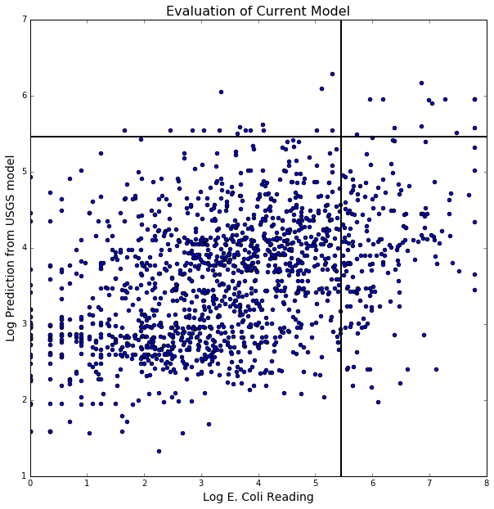
Chicago Beach Monitoring:
FP
TP
TN
FN
Notes:
Swim advisories at Chicago’s beaches are issued when test results show bacteria counts to be higher than 235 colony forming units per 100 milliliters of water, an EPA standard which is used by all Great Lakes beach managers. That means there is a 75 percent chance that at least eight out of 1,000 people will develop gastroenteritis. A swim ban is issued only for hazards like sewage spills or weather conditions.
http://chicago.suntimes.com/news/pilot-program-tests-bacteria-at-city-beaches-in-just-hours/

Slide 10
Chicago Beach Monitoring:
Specificity (Recall or TPR) : ~6%
proportion of correctly identified positives
FP
TP
TN
FN
Notes:
Regression model used. Actually a classification task at the end of the day.
Recall – Maximize for public safety
Precision – Maximize for public trust
Specificity – Maximize for reputation of beach

Slide 11
Chicago Beach Monitoring:
Sensitivity (Recall or TPR) : ~6%
proportion of correctly identified positives
Precision : ~42%
proportion of identified that are positives
FP
TP
TN
FN
Notes:
Recall – Maximize for public safety
Precision – Maximize for public trust
Specificity – Maximize for reputation of beach

Slide 12
Chicago Beach Monitoring:
Sensitivity (Recall or TPR) : ~6%
proportion of correctly identified positives
Precision : ~42%
proportion of identified that are positives
Specificity (TNR): ~98%
Proportion of correctly identified negatives
FP
TP
TN
FN
Notes:
Recall – Maximize for public safety
Precision – Maximize for public trust
Specificity – Maximize for reputation of beach

Slide 13
Chicago Beach Monitoring:
Sensitivity (Recall or TPR) : ~6%
proportion of correctly identified positives
Precision : ~42%
proportion of identified that are positives
Specificity (TNR): ~98%
Proportion of correctly identified negatives
What do we want to maximize?
Public safety
Reputation of monitoring system
Reputation of beaches
FP
TP
TN
FN
Notes:
Recall – Maximize for public safety
Precision – Maximize for public trust
Specificity – Maximize for reputation of beach
False Positive Rate (1-Specficity) chosen for calibration of classification threshold

Slide 14
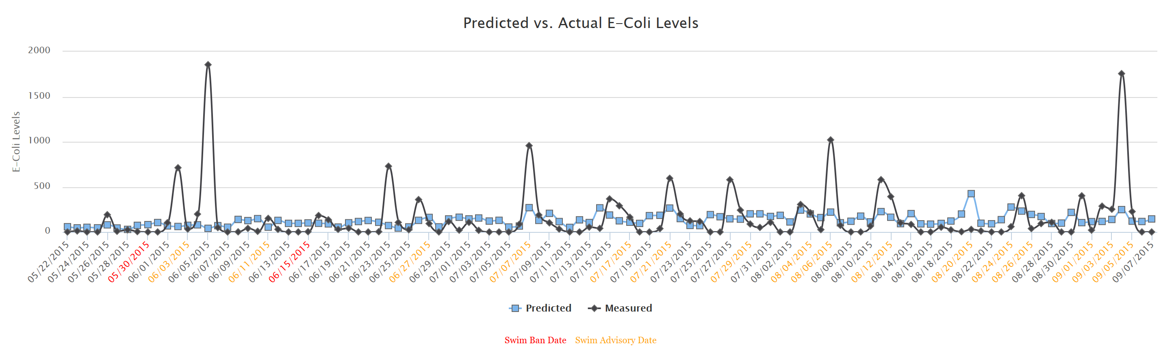
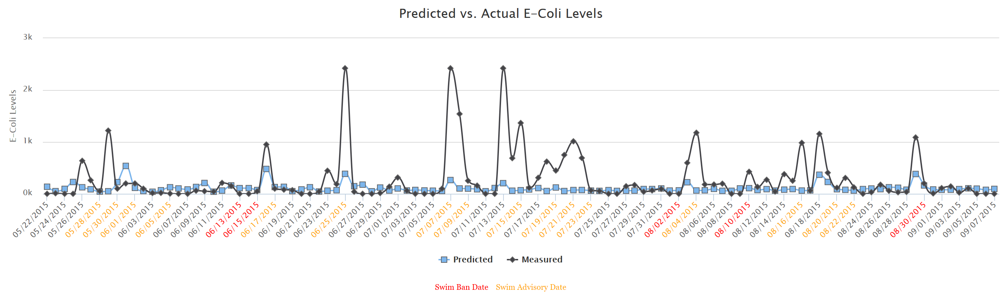
Rainbow beach
Montrose beach
From website: http://drekbeach.org/
by Scott Beslow
Notes:
Partial answer to question “Why is prediction of Ecoli so difficult”.
Note:
Swim bans and advisories result from high waves or when heavy rainfall releases sewage into the lake, rarely from ecoli predictions.
From website: http://drekbeach.org/ by Scott Beslow (Impetus for whole project!)

Slide 15
Data
Response Variable:
E Coli readings : geometric mean of two readings at each beach.
20 beaches. Measured Mon-Fri. ~75 days per year. 10 years of data.
Predictors:
Weather : temp, wind speed & direction, humidity, rain, pressure, dew point
Water Sensor Readings : turbidity, wave height, chlorophyll, ph levels
Notes:
Weather.io - easy to get data
Water sensors at three beach stations with only two years of incomplete data. So left out of modeling. Could be very useful to making better predictions in future model.
One rationale for stripped down model is cost savings of not maintaining water sensors. Can apply model to any beaches where weather and ecoli data can be collected.

Slide 16
Data
Response Variable:
E Coli readings : geometric mean of two readings at each beach.
20 beaches. Measured Mon-Fri. ~75 days per year. 10 years of data.
Predictors:
Weather : temp, wind speed & direction, humidity, rain, pressure, dew point
Water Sensor Readings : turbidity, wave height, chlorophyll, ph levels
Notes:
Weather.io - easy to get data
Water sensors at three beach stations with only two years of incomplete data. So left out of modeling. Could be very useful to making better predictions in future model.
One rationale for stripped down model is cost savings of not maintaining water sensors. Can apply model to any beaches where weather and ecoli data can be collected.

Slide 17
Data
Response Variable:
E Coli readings : geometric mean of two readings at each beach.
20 beaches. Measured Mon-Fri. ~75 days per year. 10 years of data.
Predictors:
Weather : temp, wind speed & direction, humidity, rain, pressure, dew point
Water Sensor Readings : turbidity, wave height, chlorophyll, ph levels
Engineered features : lagged variables, trailing averages,
overnight pressure change, accumulated rain,
North/South wind speed, East/West wind speed
Notes:
Hourly and Daily readings from weather. Used sparse hourly data (every 4hrs before readings taken).
Used an additive approach to model building. Base model based on which variables on their own correlated strongly with E Coli levels, then added other variables.
Kruskal-Wallis test of two populations (in this case the exceedance cases versus the non exceedance cases).

Slide 18
Modeling methods considered: Random Forests and Gradient Boosting
Bagging (RF) - averaging across independent decision tree models
Boosting (GBM) – iterative decision tree building to strengthen weak learners
Use both in combination can lower variance, give more robust results.

Slide 19
Modeling Approach: Ensembles of Random Forest and Gradient Boosting Machine Regression Trees
Process:
Remove 2015 from training data. Keep as final test set.
For each year 2006-2014, hold year of data out of training set and build model.
Calibrate decision threshold using hold out year. (set False Positive Rate to max 5%)
Test resulting set of models on 2015 data using calibrated decision thresholds.

Slide 20
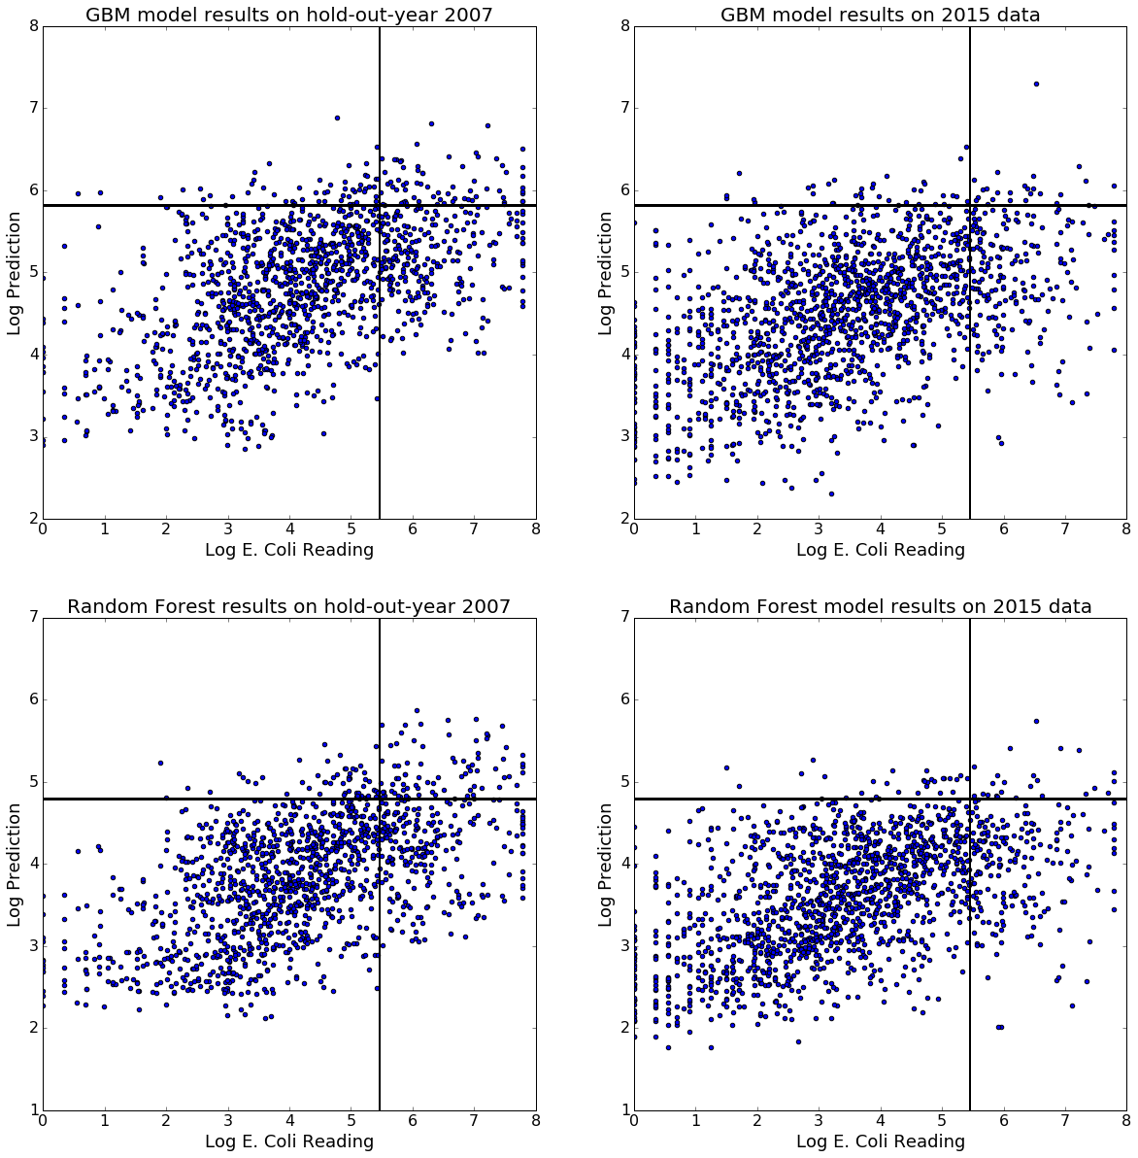
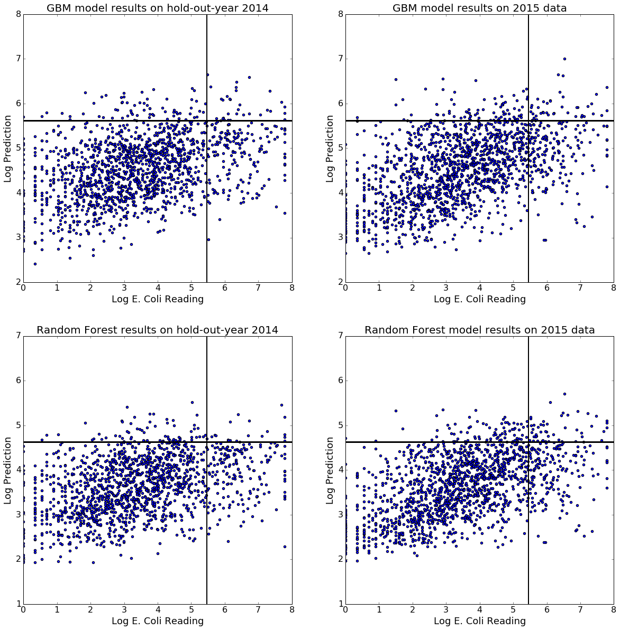
Two hold-out-year models. Example of setting and using decision threshold.
Notes:
Set decision threshold by using hold-out-year (here FNR of 5% used).
Check on 2015 data using this calibrated threshold.
Note Bias and Variance of different modeling approaches becomes apparent.
GBM uses Quantile loss function with alpha of 0.85.
<bound method BaseEstimator.get_params of GradientBoostingRegressor(alpha=0.85, init=None, learning_rate=0.025, loss='quantile', max_depth=10, max_features=None, max_leaf_nodes=None, min_samples_leaf=4, min_samples_split=10, min_weight_fraction_leaf=0.0, n_estimators=1500, random_state=None, subsample=0.8, verbose=0, warm_start=False)>
<bound method BaseEstimator.get_params of RandomForestRegressor(bootstrap=True, criterion='mse', max_depth=10, max_features=0.8, max_leaf_nodes=None, min_samples_leaf=4, min_samples_split=10, min_weight_fraction_leaf=0.0, n_estimators=500, n_jobs=-1, oob_score=True, random_state=None, verbose=0, warm_start=False)>

Slide 21
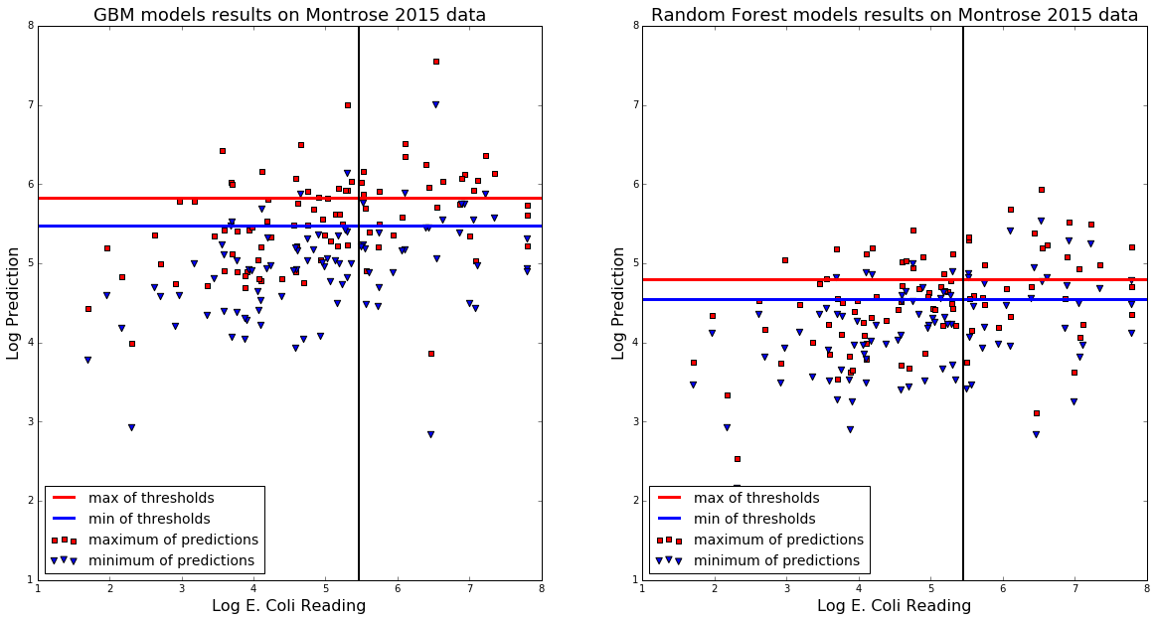
Composition and Comparison of Models
Notes:
Note that the minimum predicted for each beach-day could come from any of the nine models. Not necessarily one model that was predicting low for all or high for all.
Important to have threshold calibrated for each particular model.
Alternate composition could have been to take mean of predictions and min of thresholds.

Slide 22
Ensemble of ensembles
Final prediction
RF prediction
2006 hold out model
GBM prediction
2006 hold out model
2007 hold out model
…
2013 hold out model
2014 hold out model
2007 hold out model
…
2013 hold out model
2014 hold out model
&
Notes:
Total of 18 models in ensemble.
For each beach-day, hold-out-model uses its own appropriate decision threshold to return a binary T/F value for Ecoli exceedance.
If any of the nine RF models returns true for that beach-day, then RF prediction is True.
If any of the nine GBM models returns true for that beach-day, then GBM prediction is True.
If GBM and RF prediction both true for that beach-day, then final prediction is True, ie predict Ecoli exceedance.

Slide 23
Ensemble of ensembles
Final prediction
RF prediction
2006 hold out model
GBM prediction
2006 hold out model
2007 hold out model
each
return
T/F
2013 hold out model
2014 hold out model
2007 hold out model
each
return
T/F
2013 hold out model
2014 hold out model
&
Notes:
For each beach-day, hold-out-model uses its own appropriate decision threshold to return a binary T/F value for Ecoli exceedance.
If any of the nine RF models returns true for that beach-day, then RF prediction is True.
If any of the nine GBM models returns true for that beach-day, then GBM prediction is True.
If GBM and RF prediction both true for that beach-day, then final prediction is True, ie predict Ecoli exceedance.

Slide 24
Ensemble of ensembles
Final prediction
RF prediction
If any above T then T
2006 hold out model
GBM prediction
If any above T then T
2006 hold out model
2007 hold out model
each
return
T/F
2013 hold out model
2014 hold out model
2007 hold out model
each
return
T/F
2013 hold out model
2014 hold out model
&
Notes:
For each beach-day, hold-out-model uses its own appropriate decision threshold to return a binary T/F value for Ecoli exceedance.
If any of the nine RF models returns true for that beach-day, then RF prediction is True.
If any of the nine GBM models returns true for that beach-day, then GBM prediction is True.
If GBM and RF prediction both true for that beach-day, then final prediction is True, ie predict Ecoli exceedance.

Slide 25
Ensemble of ensembles
Final prediction
If both above T (or if USGS model T) then T
RF prediction
If any above T then T
2006 hold out model
GBM prediction
If any above T then T
2006 hold out model
2007 hold out model
each
return
T/F
2013 hold out model
2014 hold out model
2007 hold out model
each
return
T/F
2013 hold out model
2014 hold out model
&
Notes:
For each beach-day, hold-out-model uses its own appropriate decision threshold to return a binary T/F value for Ecoli exceedance.
If any of the nine RF models returns true for that beach-day, then RF prediction is True.
If any of the nine GBM models returns true for that beach-day, then GBM prediction is True.
If GBM and RF prediction both true for that beach-day, then final prediction is True, ie predict Ecoli exceedance.

Slide 26
Comparison of Current and Proposed models
Current USGS Model predictions
Ensemble of Ensemble predictions (FPR of 5%)
BEACH | incorrect_warning | correct_warning | missed_warning
Juneway | 0 | 0 | 5
Rogers | 0 | 0 | 7
Howard | 0 | 0 | 7
Jarvis | 0 | 0 | 2
Leone | 0 | 0 | 4
Albion | 0 | 0 | 6
Osterman | 0 | 0 | 14
Foster | 1 | 0 | 9
Montrose | 1 | 5 | 26
North Avenue | 0 | 0 | 5
Oak Street | 0 | 0 | 1
Ohio | 1 | 0 | 13
12th | 0 | 0 | 11
31st | 2 | 1 | 12
Oakwood | 2 | 0 | 6
57th | 2 | 1 | 4
63rd | 2 | 1 | 11
South Shore | 2 | 1 | 13
Rainbow | 3 | 4 | 17
Calumet | 0 | 0 | 30
BEACH | incorrect_warning | correct_warning | missed_warning
Juneway | 1 | 1 | 4
Rogers | 0 | 1 | 6
Howard | 1 | 1 | 6
Jarvis | 1 | 1 | 1
Leone | 2 | 0 | 4
Albion | 0 | 1 | 5
Osterman | 1 | 2 | 12
Foster | 2 | 2 | 7
Montrose | 11 | 17 | 14
North Avenue | 1 | 0 | 5
Oak Street | 0 | 0 | 1
Ohio | 2 | 1 | 12
12th | 3 | 0 | 11
31st | 7 | 1 | 12
Oakwood | 4 | 0 | 6
57th | 4 | 2 | 3
63rd | 8 | 1 | 11
South Shore | 7 | 5 | 9
Rainbow | 16 | 8 | 13
Calumet | 8 | 9 | 21
Precision: 42% Recall: 6%
Precision: 40% Recall: 24%
Notes:
Slightly more false positives. Less conservative than current model. Reputation cost for beaches vs Public safety.
More than triple the Recall (fraction of all exceedances caught by classifier).
Note that the FPR of resulting combined ensemble model is ~5.7%

Slide 27
Comparison of Current and Proposed models
Current USGS Model predictions
Ensemble of Ensemble predictions (FPR of 2%)
BEACH | incorrect_warning | correct_warning | missed_warning
Juneway | 0 | 0 | 5
Rogers | 0 | 0 | 7
Howard | 0 | 0 | 7
Jarvis | 0 | 0 | 2
Leone | 0 | 0 | 4
Albion | 0 | 0 | 6
Osterman | 0 | 0 | 14
Foster | 1 | 0 | 9
Montrose | 1 | 5 | 26
North Avenue | 0 | 0 | 5
Oak Street | 0 | 0 | 1
Ohio | 1 | 0 | 13
12th | 0 | 0 | 11
31st | 2 | 1 | 12
Oakwood | 2 | 0 | 6
57th | 2 | 1 | 4
63rd | 2 | 1 | 11
South Shore | 2 | 1 | 13
Rainbow | 3 | 4 | 17
Calumet | 0 | 0 | 30
BEACH | incorrect_warning | correct_warning | missed_warning
Juneway | 0 | 0 | 5
Rogers | 0 | 0 | 7
Howard | 0 | 0 | 7
Jarvis | 0 | 0 | 2
Leone | 0 | 0 | 4
Albion | 0 | 0 | 6
Osterman | 1 | 1 | 13
Foster | 1 | 1 | 8
Montrose | 3 | 13 | 18
North Avenue | 0 | 0 | 5
Oak Street | 0 | 0 | 1
Ohio | 1 | 0 | 13
12th | 1 | 0 | 11
31st | 2 | 1 | 12
Oakwood | 2 | 0 | 6
57th | 2 | 2 | 3
63rd | 3 | 1 | 11
South Shore | 5 | 2 | 12
Rainbow | 7 | 7 | 14
Calumet | 3 | 3 | 27
Precision: 42% Recall: 6%
Precision: 50% Recall: 14%
Notes:
Still more than double the Recall (fraction of all exceedances caught by classifier).
And the Precision is better than current model!
Note that the FPR of resulting combined ensemble model is ~2.2%

Slide 28
Collaborative Data Science : Pros
Coding improved by collaboration
Reinforces better documentation habits
Learn from style of more advanced python users
Opportunity to debate questions of data science
Learn from others
Teach others
Familiarity with collaborative tools improved
Github, slack, waffle.io

Slide 29
Collaborative Data Science : Cons
Redundancy of effort
Try something, doesn’t work. No report that it was tried.
Code not uploaded and shared. Or not documented well enough to make it useable.
Difficulty bringing people “on-board” mid-project
Documentation scattered.
Fossilized idiosyncrasies of project.

Slide 30
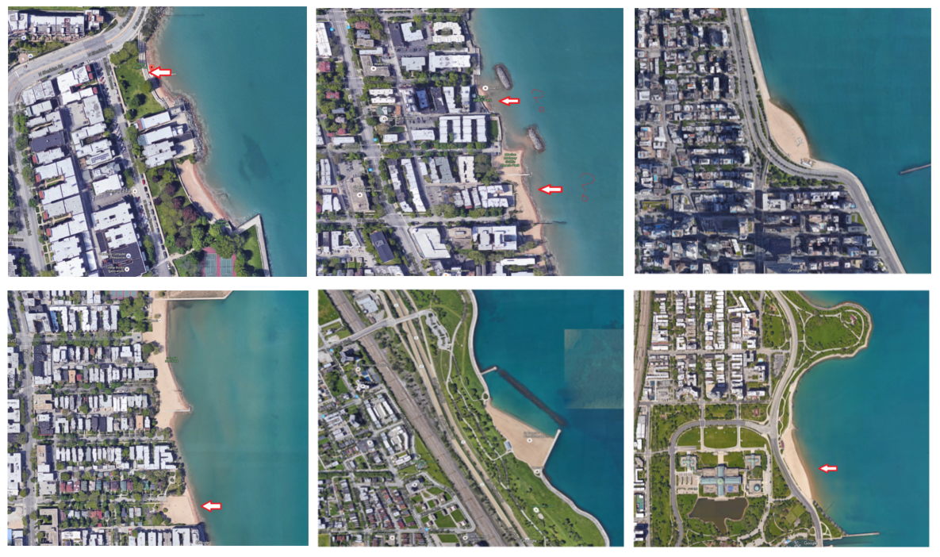
Beaches with few E. Coli exceedances
Juneway
Jarvis
Oak
Albion
Oakwood
57th Street
Notes:
Juneway, Jarvis, Oak
Albion, 39th (Oakwood), 57th
Note that the historical data for some beaches is merging two beach readings that are very close together.
The exact location of readings is not known (to me or the group building this model) but the Chicago Parks manager assured us that location of sampling was held constant over time.

Slide 31
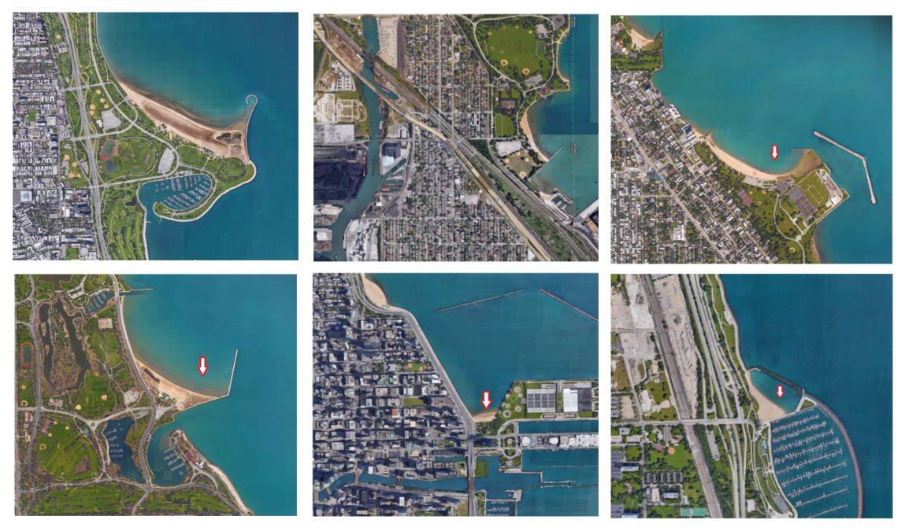
Beaches with many E. Coli exceedances
Montrose
Calumet
Rainbow
63rd Street
Ohio
31st Street
Notes:
Montrose, Calumet, Rainbow,
63rd, Ohio, 31st
These have ~3X the number of exceedances as those in previous slide.
Note that the model is currently performing very poorly on most of these, except Montrose and Rainbow which are relatively strong performers.
Images suggest what might be missing from model:
Size of beach (or estimated visitors per beach day).
Onshore wind speed. Currently only have in east/west wind magnitude, and north/south magnitude.
Not considering angle of shoreline. Barriers to currents.
Proximity to harbor? Illicit dumping from boats a possibility.

